Slide 1
Monthly Report
Larson Packaging Company Pelican Group
September 2026
Notes:
[Sources]
Google Ads account Larson Packaging Company. September 1–30, 2026 versus August 1–31, 2026. Campaign name contains Pelican, Enabled and Paused included. Read-only UI and Google Ads Advisor, accessed October 7, 2026. Conversions column used as leads. Combined CPL = total cost / total conversions. No campaign changes. Account timezone Pacific Time.
Analysis adapted from Google Ads Advisor and reconciled against direct UI totals.

Slide 2
Account overview
Key Metric | September 2026 | August 2026 | Change
Cost | 1,982.69 | 1,978.12 | (+0.23%)
Impression | 15,230 | 14,585 | (+4.42%)
Click | 939 | 504 | (+86.31%)
CPC | 2.11 | 3.92 | (-46.20%)
CTR | 6.17% | 3.46% | (+78.42%)
Lead | 13.00 | 12.00 | (+8.33%)
CPL (Pelican total) | 152.51 | 164.84 | (-7.48%)
Notes:
[Sources]
Google Ads account Larson Packaging Company. September 1–30, 2026 versus August 1–31, 2026. Campaign name contains Pelican, Enabled and Paused included. Read-only UI and Google Ads Advisor, accessed October 7, 2026. Conversions column used as leads. Combined CPL = total cost / total conversions. No campaign changes. Account timezone Pacific Time.
Analysis adapted from Google Ads Advisor and reconciled against direct UI totals.

Slide 3
Account overview
Overall traffic increased
Though we have spent the same budget, your impression increased 4.4% and click increased 86%
Overall performance increased
CPL reduced 7.5%, from $164.8 to 152.5
01
02
CTR increased from 3.5% to 6.2% means the system has reach the right audience
Combining Pmax and search campaign is the key to improve Click rate and conversion rate
03
04
Overall, this month performance and traffic improved.
05
Notes:
[Sources]
Google Ads account Larson Packaging Company. September 1–30, 2026 versus August 1–31, 2026. Campaign name contains Pelican, Enabled and Paused included. Read-only UI and Google Ads Advisor, accessed October 7, 2026. Conversions column used as leads. Combined CPL = total cost / total conversions. No campaign changes. Account timezone Pacific Time.
Analysis adapted from Google Ads Advisor and reconciled against direct UI totals.

Slide 4
Keyword Analytics: Pelican Group
Search keyword
September 1, 2026 - September 30, 2026
Search keyword | Search keyword match type | Ad group | Clicks | Impr. | CTR | Avg. CPC | Cost | Conversions | Cost / conv. | Conv. rate | Avg. CPM
custom foam cases | Broad match | ontario | 86 | 1,489 | 5.78% | 4.10 | 352.56 | 5.00 | 70.51 | 5.81% | 236.78
pelican cases | Broad match | ontario | 85 | 2,002 | 4.25% | 4.19 | 356.00 | 3.00 | 118.67 | 3.53% | 177.82
custom foam cases | Broad match | bay area | 42 | 577 | 7.28% | 4.33 | 181.72 | 1.00 | 181.72 | 2.38% | 314.94
pelican cases | Broad match | bay area | 51 | 971 | 5.25% | 3.05 | 155.49 | 1.00 | 155.49 | 1.96% | 160.13
skb cases | Broad match | ontario | 8 | 219 | 3.65% | 2.73 | 21.86 | 1.00 | 21.86 | 12.50% | 99.82
pelican cases | Broad match | san diego | 27 | 505 | 5.35% | 2.63 | 70.98 | 0.00 | — | 0.00% | 140.55
custom foam cases | Broad match | san diego | 13 | 242 | 5.37% | 5.18 | 67.36 | 0.00 | — | 0.00% | 278.35
protector case | Broad match | ontario | 7 | 213 | 3.29% | 3.73 | 26.12 | 0.00 | — | 0.00% | 122.63
gun cases | Broad match | ontario | 3 | 40 | 7.50% | 4.16 | 12.47 | 0.00 | — | 0.00% | 311.75
Notes:
[Sources]
Google Ads account Larson Packaging Company. September 1–30, 2026 versus August 1–31, 2026. Campaign name contains Pelican, Enabled and Paused included. Read-only UI and Google Ads Advisor, accessed October 7, 2026. Conversions column used as leads. Combined CPL = total cost / total conversions. No campaign changes. Account timezone Pacific Time.
Search keywords sorted by conversions, then cost. Nine spending rows. Avg. CPM calculated as cost / impressions * 1000. Zero-conversion CPL shown as unavailable. Keyword totals differ from campaign totals.

Slide 5
Keyword Analytics: Pelican Group
Top Pelican Keywords
“custom foam cases” in Ontario led with 5 conversions at $70.51 CPL. “pelican cases” in Ontario added 3 at $118.67. “skb cases” delivered 1 at $21.86, from only 8 clicks.
Search Intent & Competition
The strongest converting terms focus on cases and custom foam. Advisor recommends reviewing these themes for expansion. Validate search terms and lead quality before scaling.
Ad Engagement
Ontario “custom foam cases” recorded 86 clicks and 5.78% CTR. Ontario “pelican cases” recorded 85 clicks and 4.25% CTR. “skb cases” recorded 3.65% CTR. San Diego case terms spent $138.34 without a conversion this month.
Notes:
[Sources]
Google Ads account Larson Packaging Company. September 1–30, 2026 versus August 1–31, 2026. Campaign name contains Pelican, Enabled and Paused included. Read-only UI and Google Ads Advisor, accessed October 7, 2026. Conversions column used as leads. Combined CPL = total cost / total conversions. No campaign changes. Account timezone Pacific Time.
Analysis adapted from Google Ads Advisor and reconciled against direct UI totals.

Slide 6
Domain overview: Customcase
Google / cpc supplied 944 of 1,060 new users (89.06%) and 1,055 of 1,195 sessions (88.28%). Direct ranked second for both metrics. Other combines every source outside the top three.
Notes:
[Sources]
Google Ads account Larson Packaging Company. September 1–30, 2026 versus August 1–31, 2026. Campaign name contains Pelican, Enabled and Paused included. Read-only UI and Google Ads Advisor, accessed October 7, 2026. Conversions column used as leads. Combined CPL = total cost / total conversions. No campaign changes. Account timezone Pacific Time.
GA4 property Pelican - Larson Packaging (433428820). User acquisition metric New users by First user source / medium. Traffic acquisition metric Sessions by Session source / medium. September 1–30. Duplicate source rows aggregated. Top three by each metric plus Other. New users 1060; sessions 1195.

Slide 7
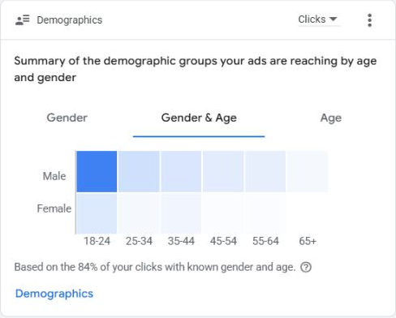
Age and gender report
Audience engagement
The Gender & Age clicks card shows the strongest engagement among men aged 18–24. Male users also account for the darker cells across most age groups.
Coverage
Group 18-24 tributes less to conversion. we will exclude it in next month
Notes:
[Sources]
Google Ads account Larson Packaging Company. September 1–30, 2026 versus August 1–31, 2026. Campaign name contains Pelican, Enabled and Paused included. Read-only UI and Google Ads Advisor, accessed October 7, 2026. Conversions column used as leads. Combined CPL = total cost / total conversions. No campaign changes. Account timezone Pacific Time.
Screenshot: Google Ads Overview Gender & Age, Clicks. Only 84% known gender and age. Commentary adapted from Advisor, retaining card-grounded observations only.

Slide 8
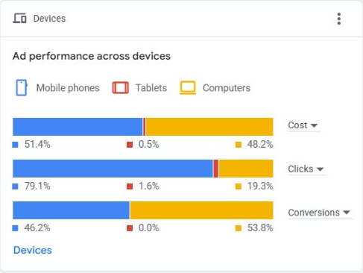
Device Report
Device performance
Computers generated 7 conversions at $136.39 CPL, compared with 6 on mobile at $169.83. Tablets spent $9.01 without a conversion.
Engagement mix
Mobile generated 79.1% of clicks but 46.2% of conversions. Computers generated 19.3% of clicks and 53.8% of conversions.
Notes:
[Sources]
Google Ads account Larson Packaging Company. September 1–30, 2026 versus August 1–31, 2026. Campaign name contains Pelican, Enabled and Paused included. Read-only UI and Google Ads Advisor, accessed October 7, 2026. Conversions column used as leads. Combined CPL = total cost / total conversions. No campaign changes. Account timezone Pacific Time.
Screenshot: Overview Devices with Cost, Clicks and ALL Conversions selected. Device cost and conversion totals independently reconciled. Computer CPL 954.72/7; mobile 1018.96/6. Advisor bid recommendation framed for review, no changes applied.

Slide 9
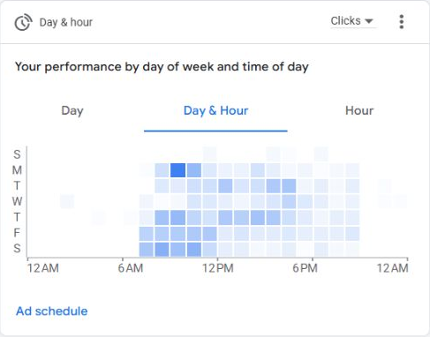
Ad schedule report
Day & hour engagement
The clicks heatmap shows activity concentrated from morning through early evening, with the darkest cell on Monday morning. Friday and Saturday also show engagement.
Notes:
[Sources]
Google Ads account Larson Packaging Company. September 1–30, 2026 versus August 1–31, 2026. Campaign name contains Pelican, Enabled and Paused included. Read-only UI and Google Ads Advisor, accessed October 7, 2026. Conversions column used as leads. Combined CPL = total cost / total conversions. No campaign changes. Account timezone Pacific Time.
Screenshot: Overview Day & Hour, Clicks. Advisor recommendation to retain consistent schedule. Exact hourly conversions omitted because not independently verified.

Slide 10
Locations - September 2026
Regional performance
California generated 10 conversions at $116.49 CPL. Silicon Valley generated 1 at $159.72. San Francisco Bay Area generated 2 at $329.03.
Efficiency
Bay Area used 33.19% of spend for 15.38% of conversions, making it the highest-CPL reported region.
Advisor recommendation
Review Bay Area search terms for overly broad retail queries before allocating more budget. Regional samples remain small.
Notes:
[Sources]
Google Ads account Larson Packaging Company. September 1–30, 2026 versus August 1–31, 2026. Campaign name contains Pelican, Enabled and Paused included. Read-only UI and Google Ads Advisor, accessed October 7, 2026. Conversions column used as leads. Combined CPL = total cost / total conversions. No campaign changes. Account timezone Pacific Time.
Matched locations narrowed United States to Regions. Table-level Campaign name contains pelican. California 1164.91/10, Bay Area 658.06/2, Silicon Valley159.72/1. Labels reproduce Google Ads region categories, not disjoint administrative states. Three original series retained: Cost, Conversion, Cost/conversion.

Slide 11
Conclusion
In September, our traffic greatly increased with CPC reduced 46% and impression increased 4.4%.
Our performance slightly increased as well, CPL reduced 7.5%.
In next month, we will exclude 18-24 group.
Consider turning off or split campaign for bay area as this location has the lowest performance
Notes:
[Sources]
Google Ads account Larson Packaging Company. September 1–30, 2026 versus August 1–31, 2026. Campaign name contains Pelican, Enabled and Paused included. Read-only UI and Google Ads Advisor, accessed October 7, 2026. Conversions column used as leads. Combined CPL = total cost / total conversions. No campaign changes. Account timezone Pacific Time.
Analysis adapted from Google Ads Advisor and reconciled against direct UI totals.

